Slide 1
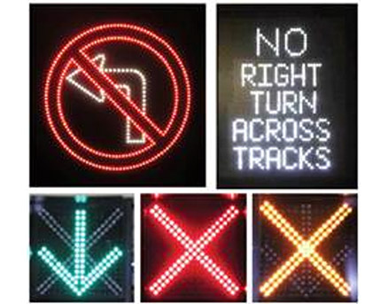
Smart Connected Sign Boards For Improved Road Safety
By:
G. Hima Vamsi
T. Likhitha
P. Sharanya
M. Revanth Kumar

Slide 2
CONTENTS
Abstract
Problem Statement
Introduction
Requirements
Implementation
Result
Conclusion

Slide 3
ABSTRACT
The lack of traffic signal striking is often cited as a contributing factor by drivers who are involved in accidents at intersections. As such, increasing the striking of traffic signals should lead to improved safety performance.
This document describes a project to determine the road safety effectiveness associated with improved signals with smart connected sign boards. A smart road using IOT devices is a special idea which makes the drivers to drive safer than before.

Slide 4
The first motive of smart connected sign boards is to provide safety, avoid accidents and reduce traffic. This can be implemented by using Nodemcu, Push button, Weather API.
Traffic is a growing problem in India causing fuel wastage, time wastage & pollution. In Indian road-traffic, the problems like crowded roads, unpredictable time to travel from one place to another are a serious problems which is also polluted and noisy.
Now, researchers have started to introduce smart connected signals technology which is difficult to implement on roads. In this project, we present a low cost innovative technology for smart connected sign boards for improved road safety. Different technologies have been introduced to increase road safety.

Slide 5
PROBLEM STATEMENT
In India we see traffic junction, we can see traffic signals with red, yellow and green lights along with the timer display. To move the traffic has to wait for a fixed interval of time. For example, people have to wait for a small interval of time which is fixed for every signal even though the traffic is more in that particular lane. This leads to a huge “TRAFFIC JAM” which is a major problem now a days the society is facing. Due to this heavy traffic, the number of road accidents are increased which is a major issue. Our project helps to decrease the number of road accidents using smart connected sign boards using Internet Of things (IOT).

Slide 6
INTRODUCTION
Nowadays traffic has become a major problem for the people in India. Due to which it causes wastage of precious time, fuel and electricity. The Internet of things (IOT) is the network of electrical appliances, vehicles, physical devices and other items embedded with electronics, actuators, sensors, software, and connectivity which enables all these objects to connect and exchange data. Each thing is uniquely identifiable through its embedded computing system but is able to inter-operate within the existing Internet infrastructure.

Slide 7
In present Systems the road signs and the speed limits are Static. But the road signs can be changed in some cases. We can consider some cases when there are some road diversions due to heavy traffic or due to accidents then we can change the road signs accordingly if they are digitalized. This project proposes a system which has digital sign boards on which the signs can be changed dynamically.
By using the Weather API we can get the weather reports based on which we can set the speed limit to particular area. If there is rainfall then the roads will be slippery and the speed limit would be decreased. There is a web app through which you can enter the data of the road diversions, accident prone areas and the information sign boards can be entered through web app.

Slide 8
REQUIREMENTS
Hardware Requirements:
Software Requirements:
Arduino IDE
Weather API
IBM Cloud Platform
NODEMCU (12-E)
PUSH BUTTON
OLED DISPLAY

Slide 9
IMPLEMENTATION
OLED pins 3V3, GND, SCL, SDA are connected to VCC, GND, D1, D2 of Nodemcu pins respectively.
We run the programs using Arduino.
Those programs which are executed using Arduino are uploaded into the Nodemcu using USB cable.

Slide 10
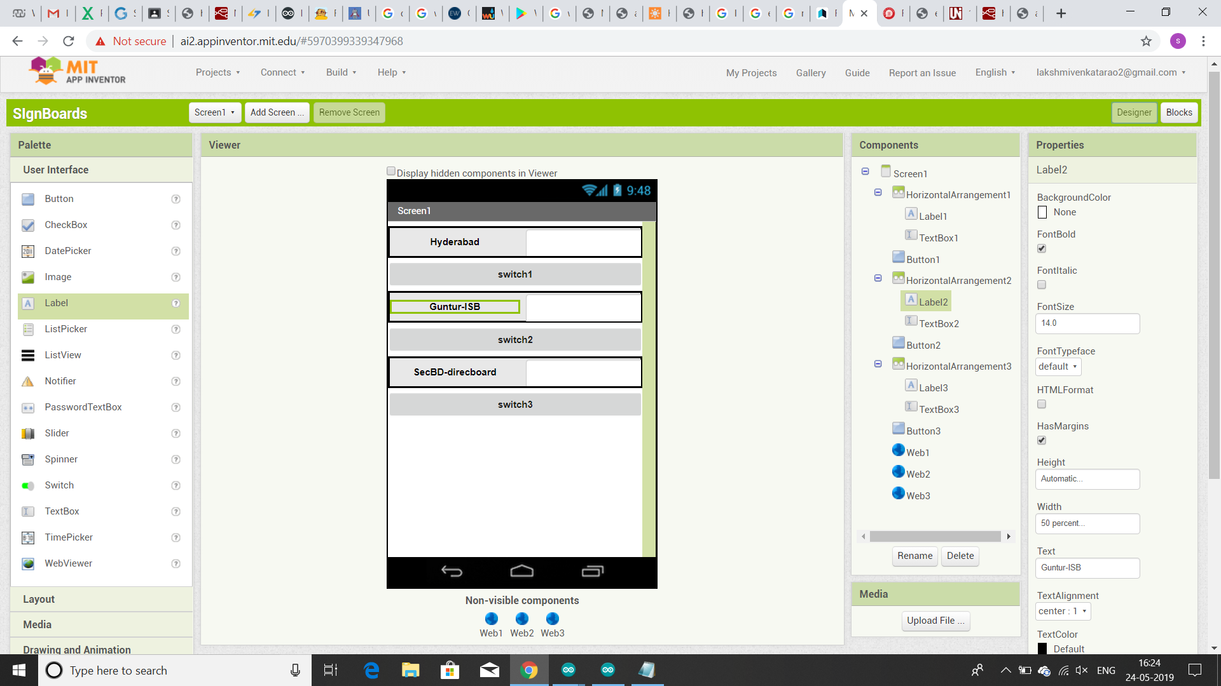
Web App
Using MIT app inventor, we create our app.
According to our app we create three text boxes in which we can enter desirable data.
After entering the data in the text box, there a button present which is to be tapped.

Slide 11
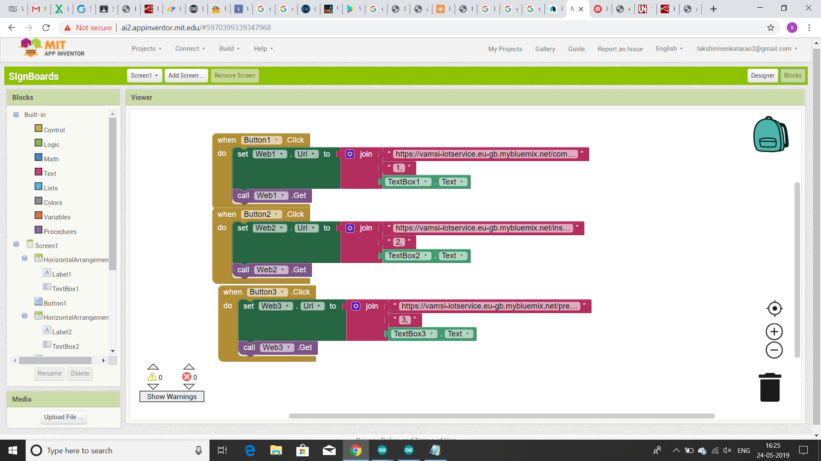
Functionality
On click function of the button, the page will be directed to the URL which is of NodeRed (IBM Cloud).

Slide 12
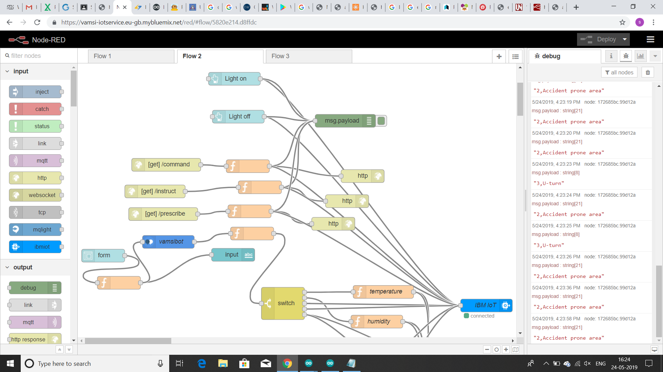
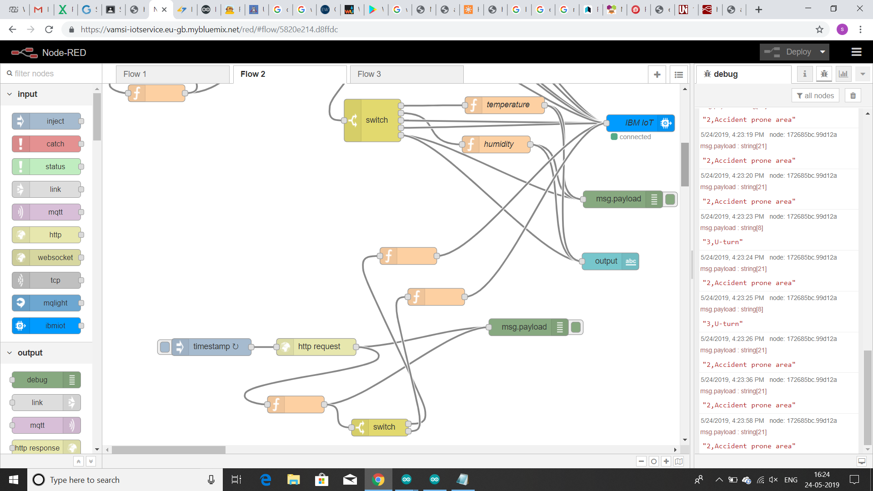
The data is sent to device (Nodemcu) from cloud. The output is displayed on OLED display after receiving data from Nodemcu.

Slide 13
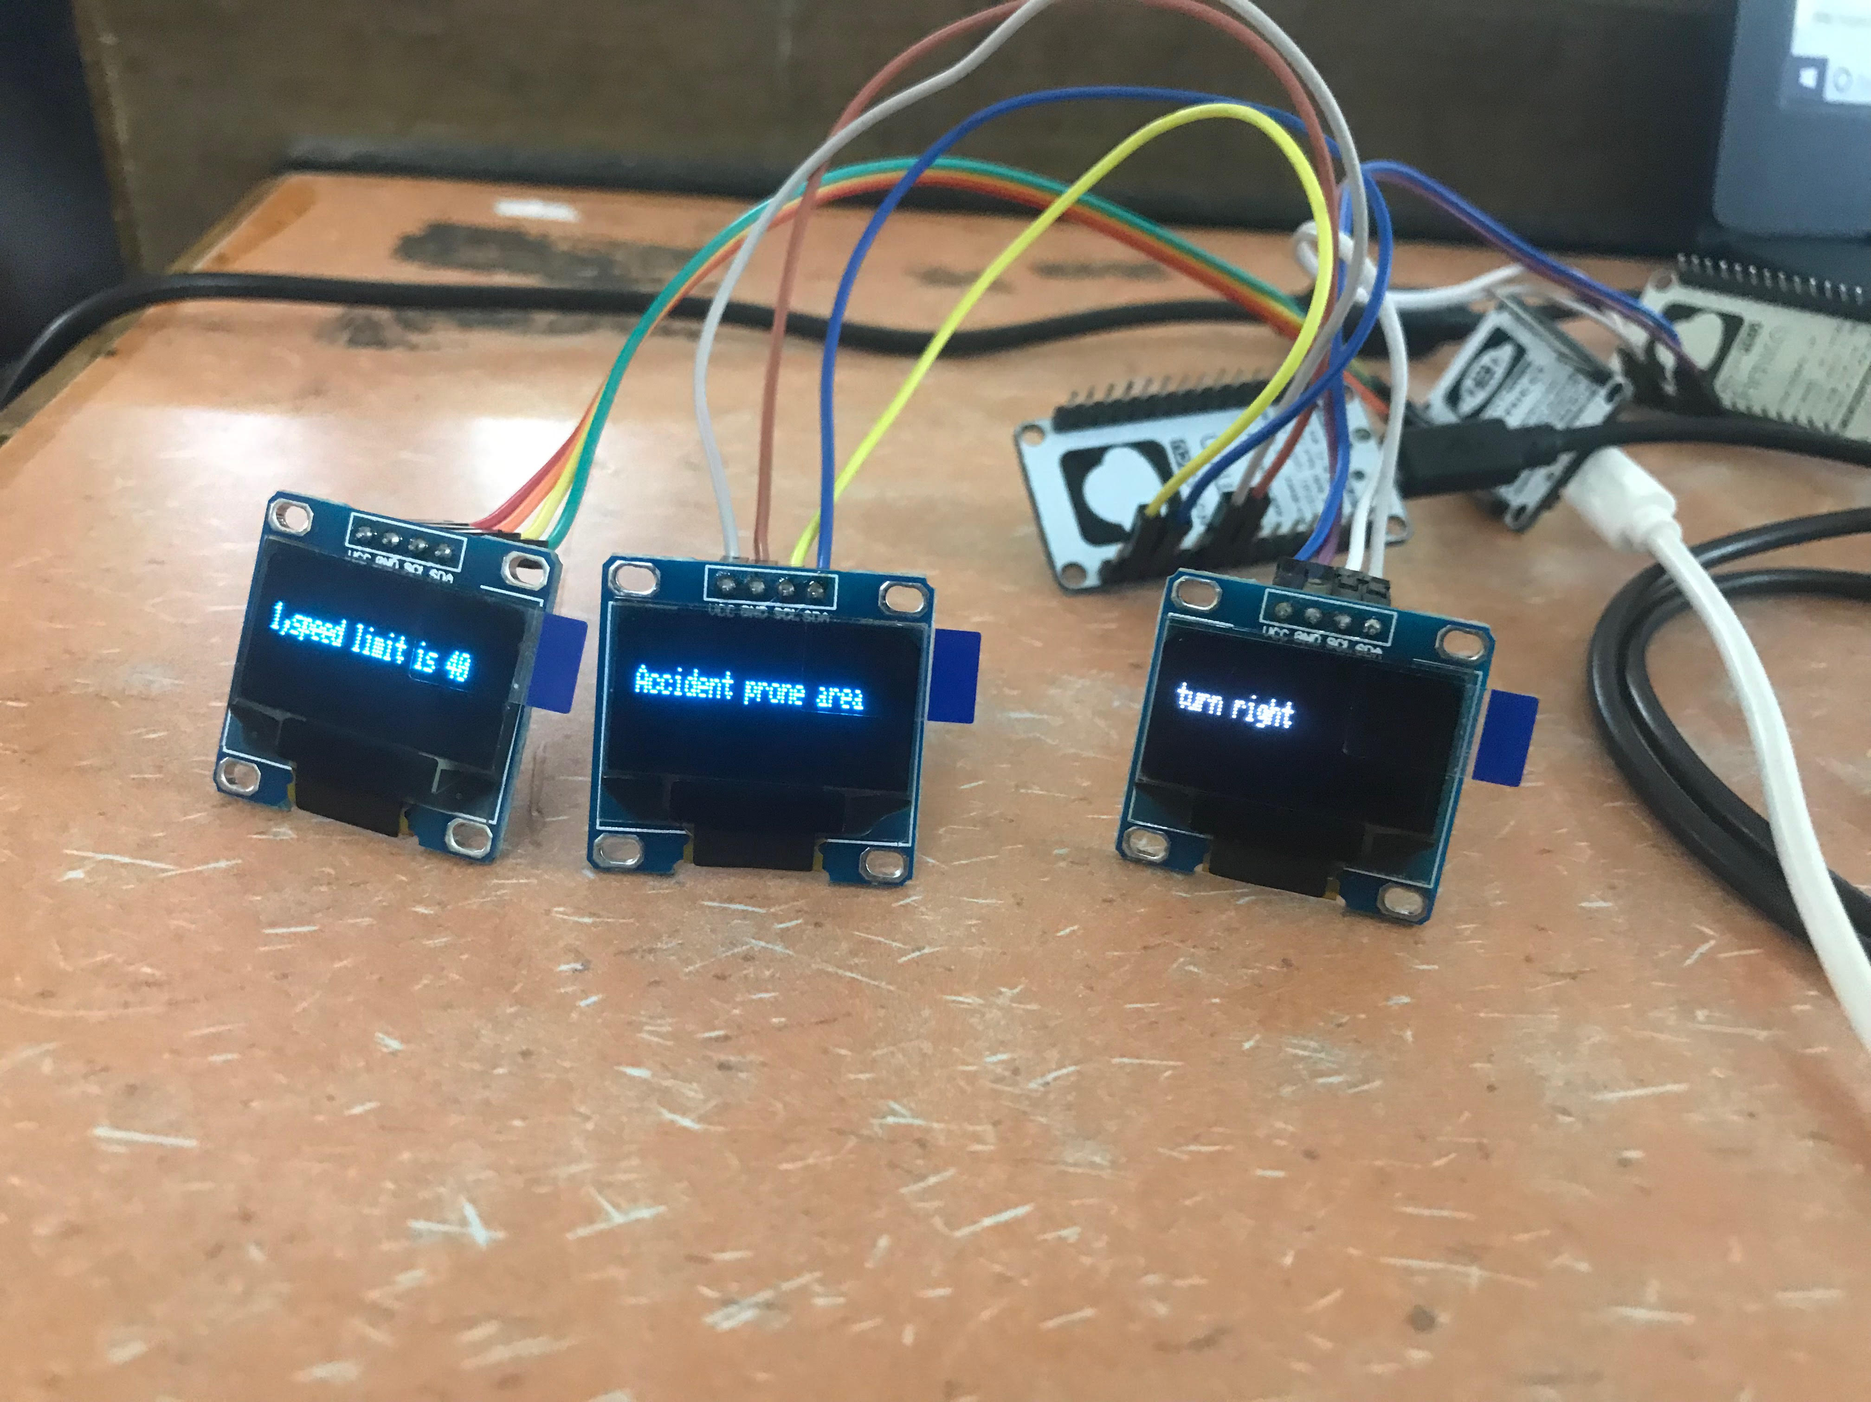
RESULT
The first OLED display shows speed limit using weather API.
The second OLED display shows about the alerts of the accident prone area.
The third OLED display shows the information sign boards.

Slide 14
CONCLUSION
This project proposes a system which has digital sign boards on which the signs can be changed dynamically. There is a web app through which you can enter the data of the road diversions, accident prone areas and the information sign boards can be entered through web app. This data is retrieved and displayed on the sign boards accordingly.

